Slide 1


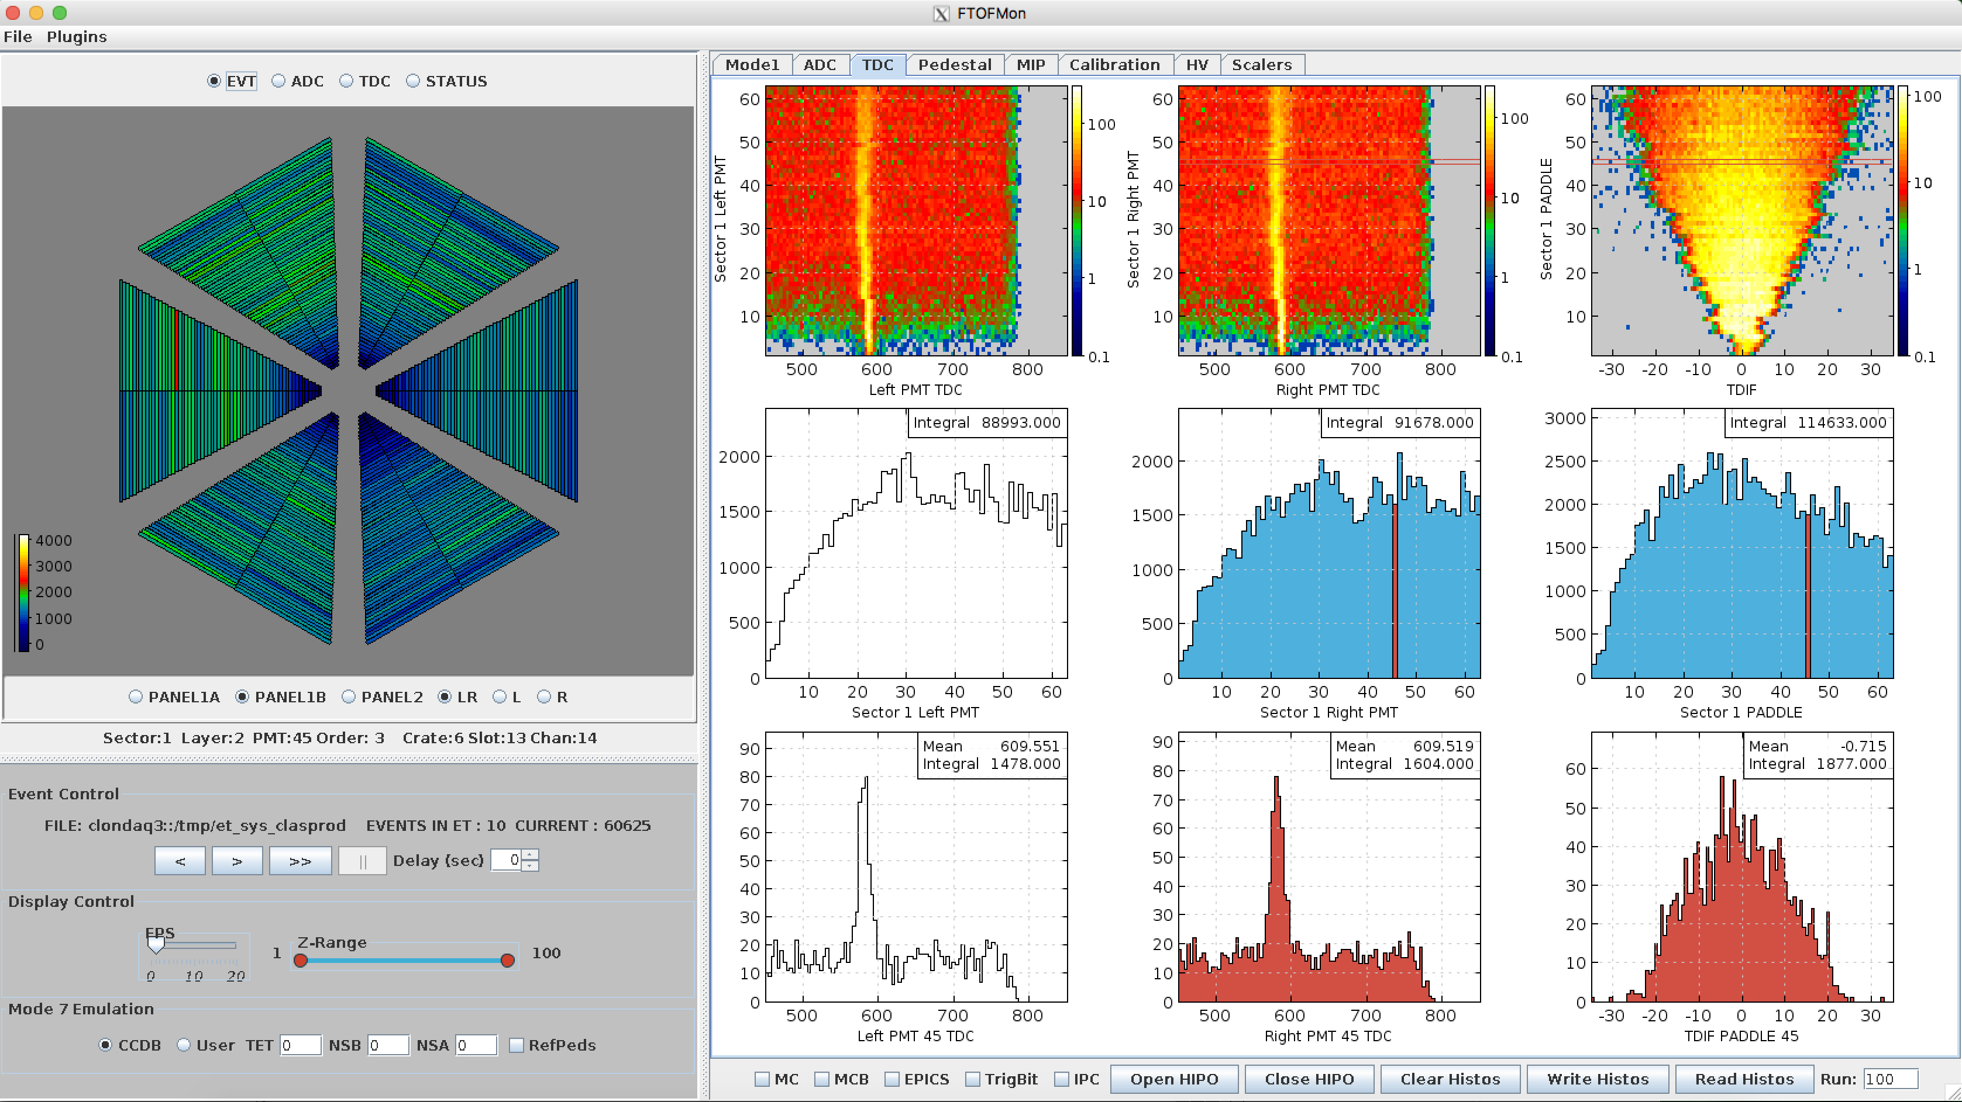
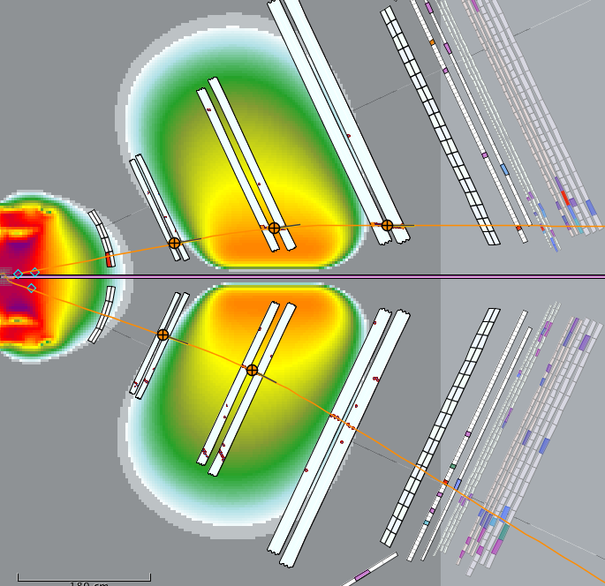
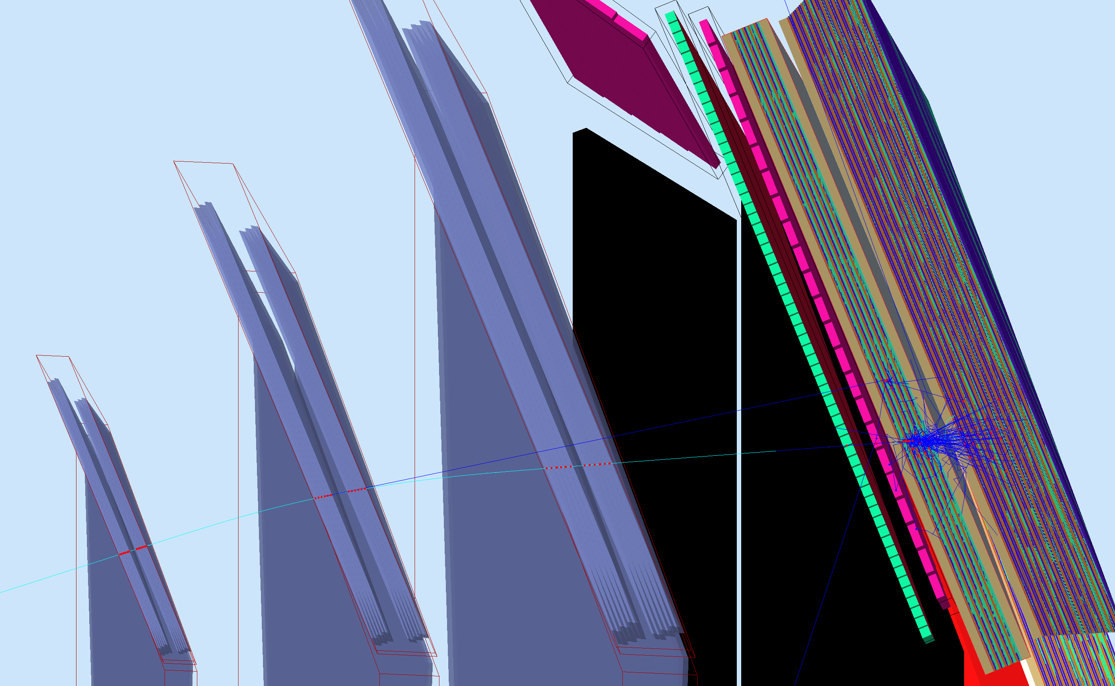
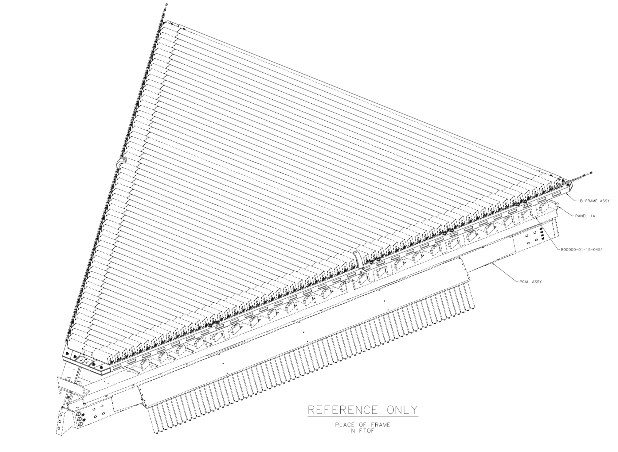
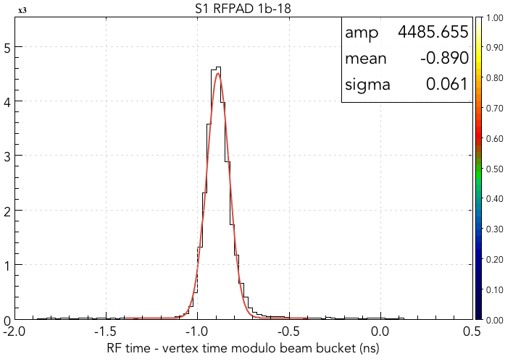
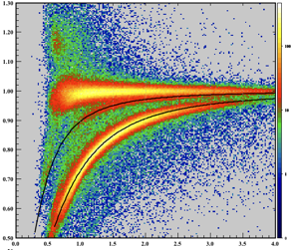
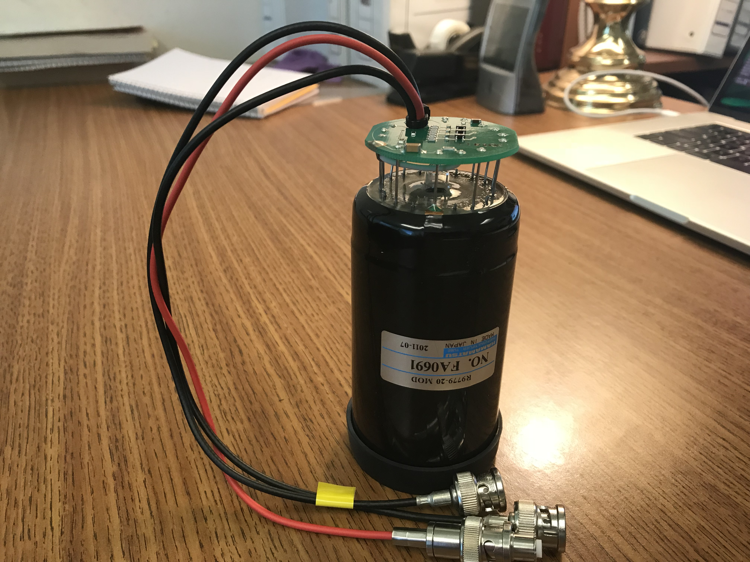
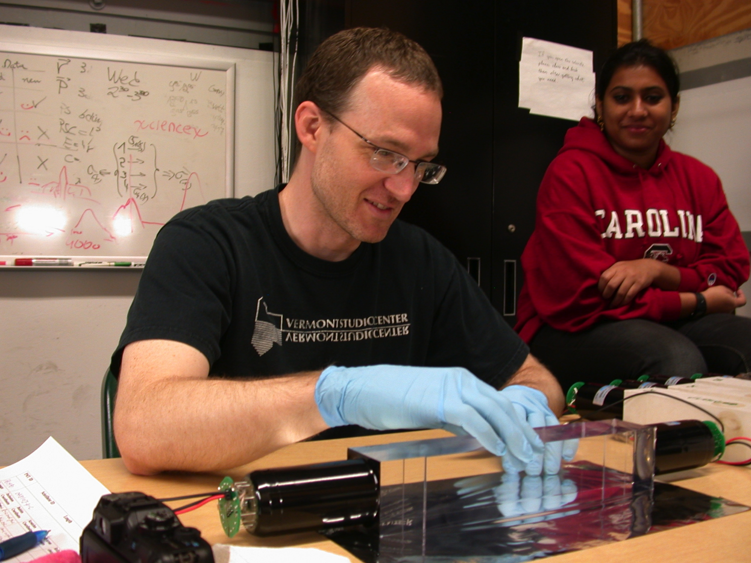
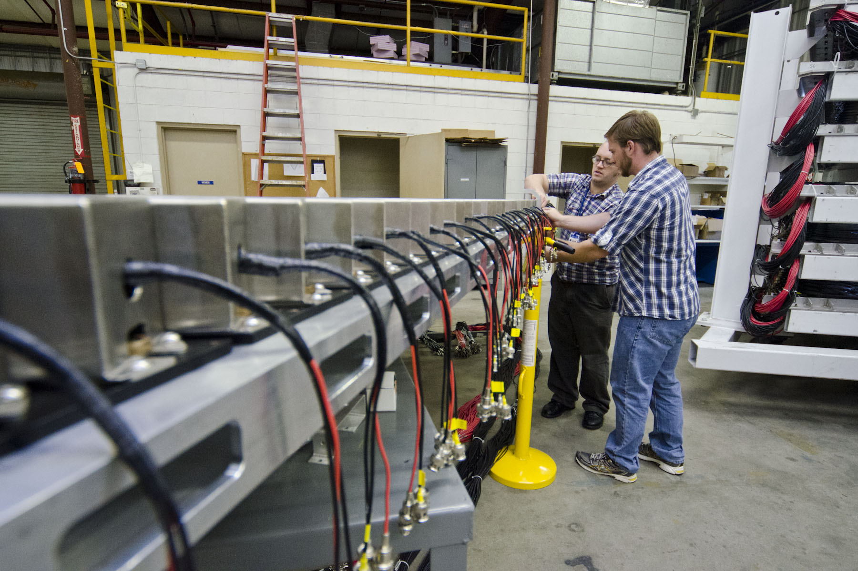
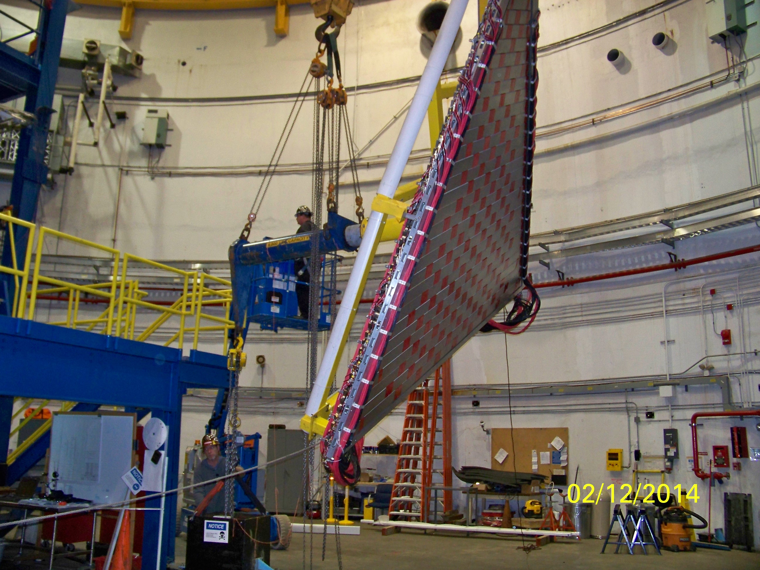
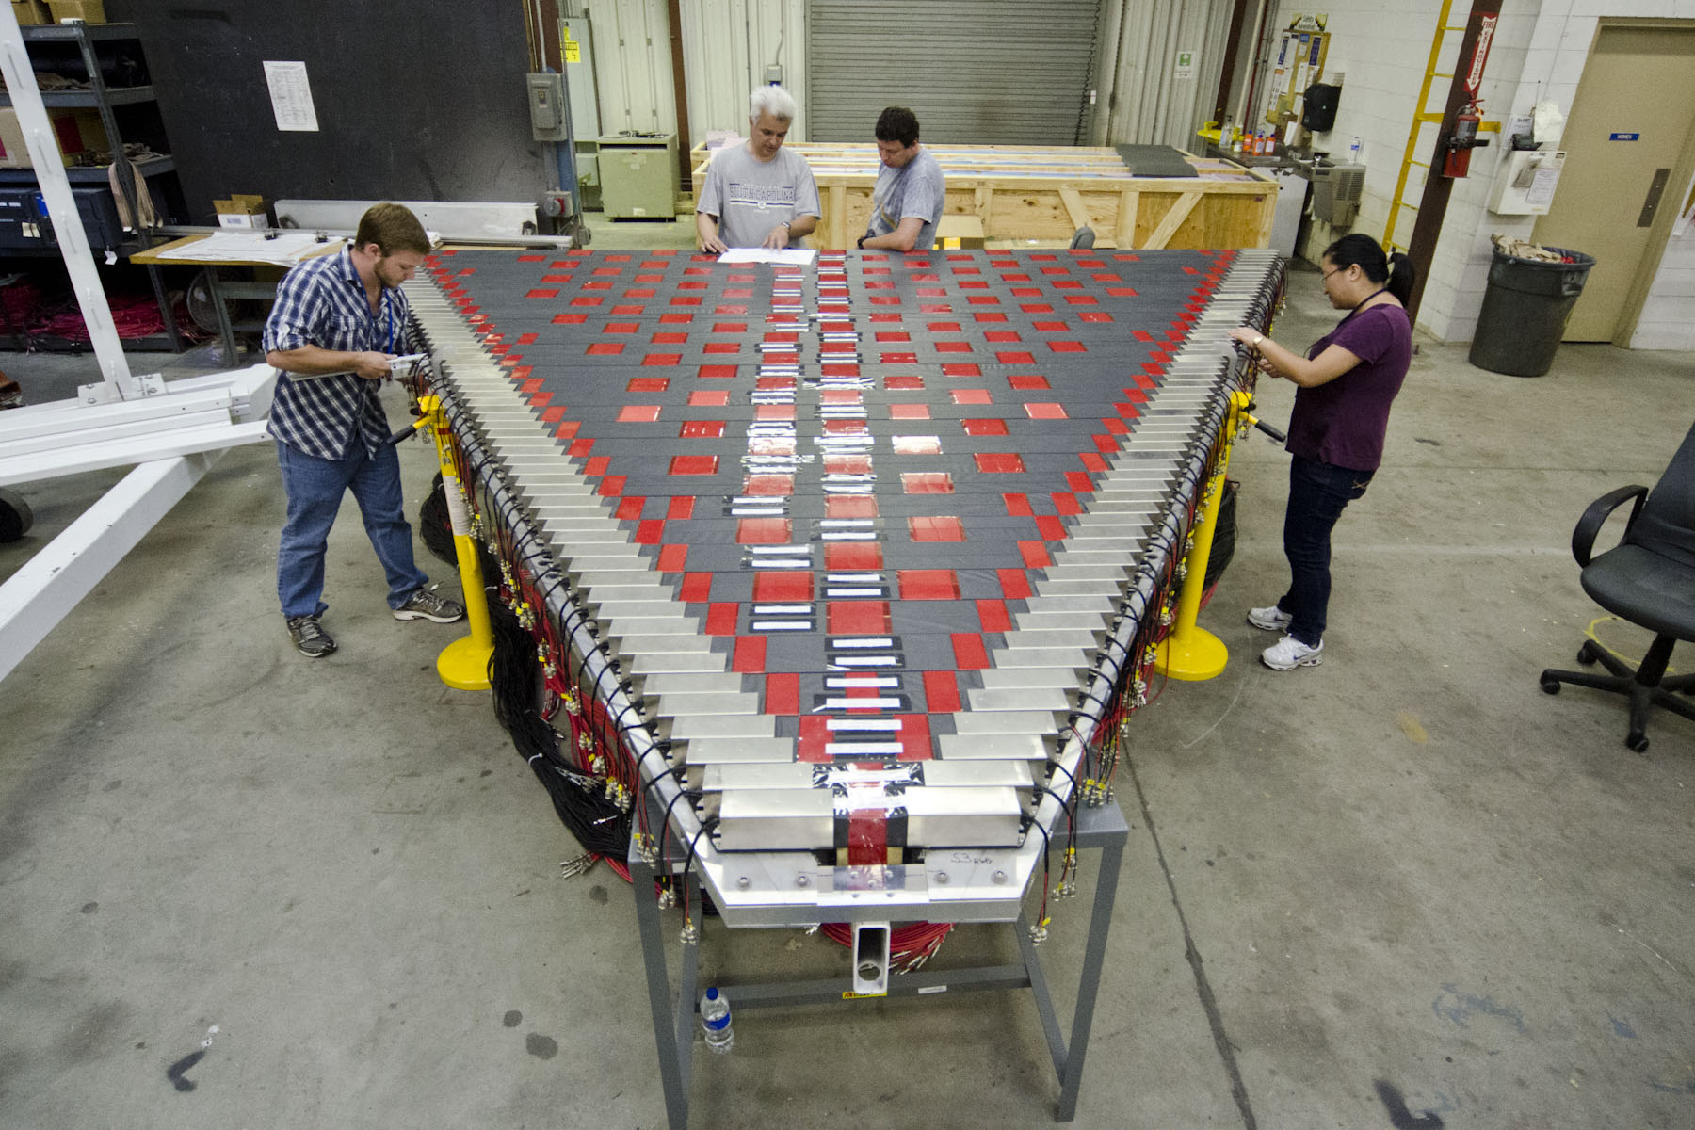
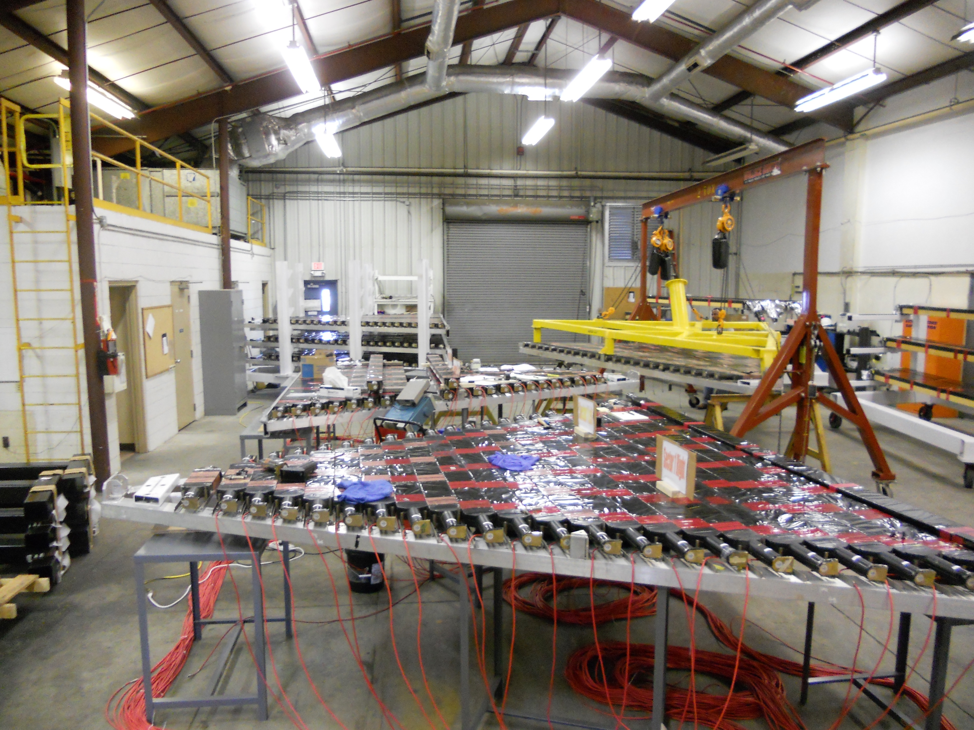
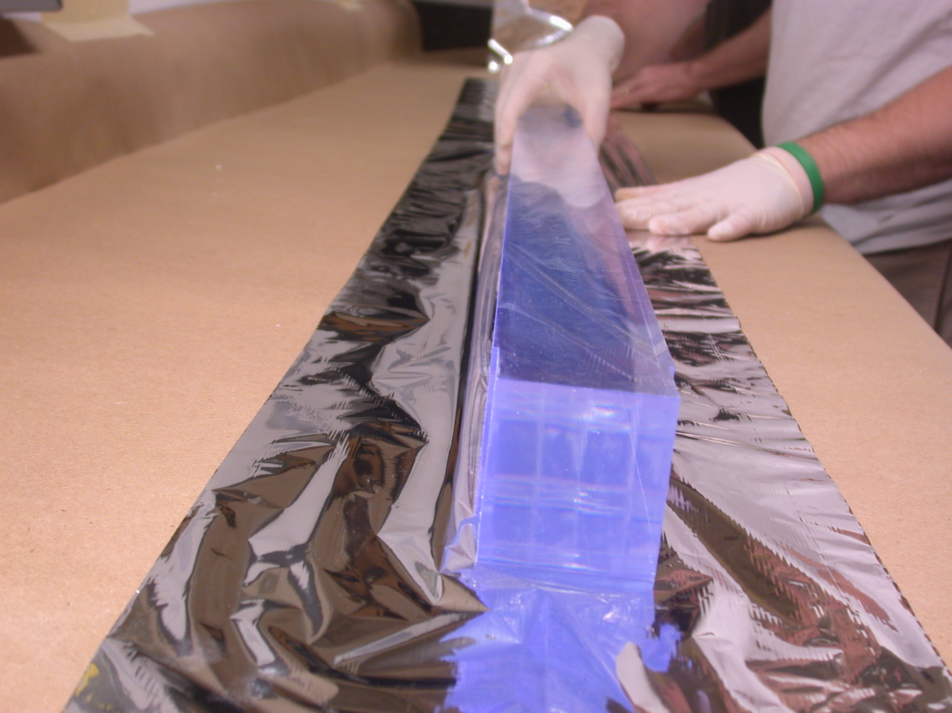
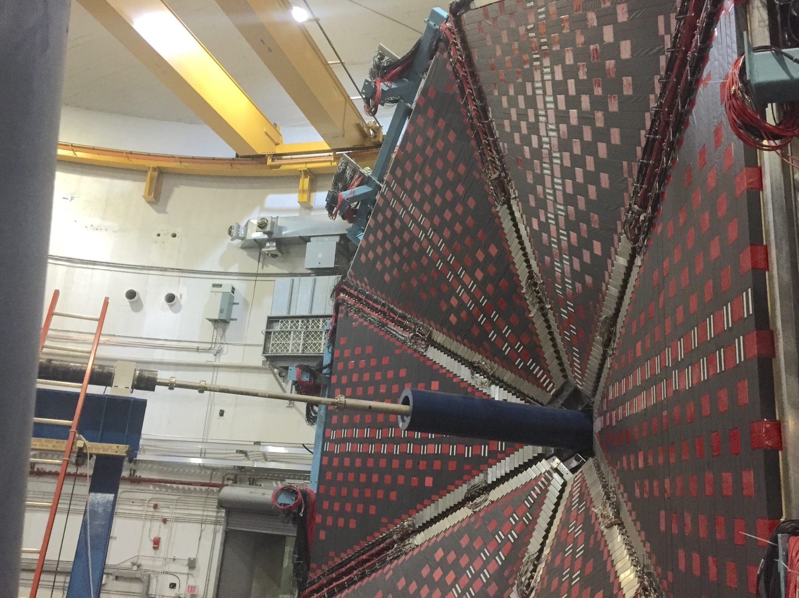
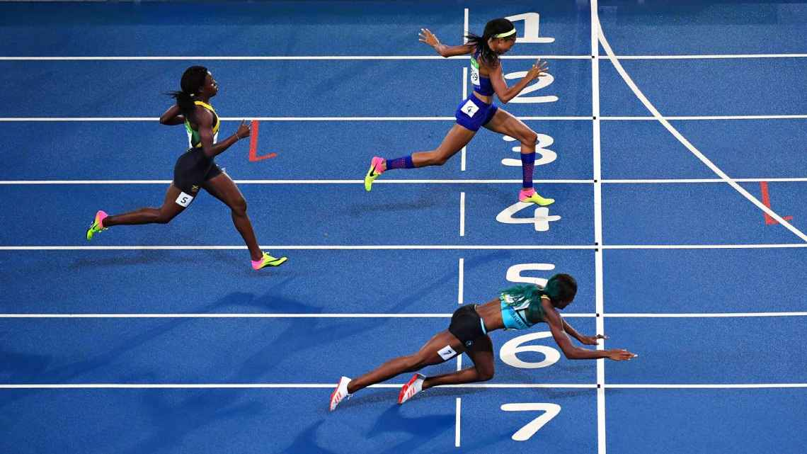
Forward Time Of Flight (FTOF)
Thomas Jefferson National Accelerator Facility
What is it?
FTOF In Action
The Forward Time Of Flight is used to determine:
the precise flight time of passing charged particles;
the types of charged particles (pions, kaons, protons, etc.).
When charged particles cross paddles they cause the special material to emit light. We call this process a “hit”. The photons are collected at each end by light guides that channels them to photo-multipliers, connected to computers.
Dedicated software then calculates the position and time of the particle hits, and based on this information we can distinguish the particle types, e.g. protons, pion, kaons, etc.
DC Region 2
DC Region 3
DC Region 1
FTOF Panels
DC Region 2
DC Region 3
A representation of a single collision event taken in April 2018.
We collect about 10000 of these events every second.
You can see the particles hitting various detectors, including the FTOF.
DC Region 1
FTOF
Panels
FTOF Paddles
Hits in FTOF
Sensitive photo-detectors
The software suite that we use to monitor every counter in the FTOF system hardware.
Computer simulation of an electron passing through the Drift Chambers, the FTOF and showering in the PCAL and ECAL calorimeters.
The FTOF hits provide a world-record timing that we use to calculate the event start time and to identify the type of particle: electron, pion, proton, kaon, etc.
One FTOF “B” panel, containing 62 paddles. The “A” panels have 23 and the ”2” panels have 5 large paddles. The FTOF system consists of 18 panels for a total 540 paddles.
The light created in the counters from particles passing trough is collected with sensitive photo-detectors mounted at each end of the individual counters. The electrical signals produced by these hits are collected in our computer electronics.
β
PIONS
pions
Tech Specs
kaons
protons
540 counters
1080 photo sensors
2160 readout channels
Double-sided readout via 2-in and 3-in PMTs
Rectangular counters come in widths of 6 cm, 15 cm, 22 cm
Lengths vary from 17 cm to ~426 cm
Timing resolution ~30 – 165 ps depending on counter length
Position resolution along counter ~1 cm
Angular Coverage: Polar: 5º-35º (panel-1a, panel-1b); 35º-45º (panel-2)
p (GeV)
One of the 1080 photo-sensor used in FTOF
Time resolution measurement of one FTOF counter: 0.061x10⁻⁹ s (61 ps). That means we can distinguish events in time to within 1/10 of a billion of a second.
Hello particles! This plot show the relativistic speed versus momentum of the particles hitting the FTOF. Thanks to FTOF, we are able to differentiate between protons, kaons, and pions.
Building and Installing the FTOF
Did you know?
A particle crossing one paddle releases around 4000 photons. Of these, about 2000 make it to the photo sensor. This looks like a lot of photons but the signal produced is very tiny and it needs to be amplified by a factor of one million to make it visible to the electronics.
The light produced by crossing particles bounces across the scintillator and light guides around 20 times before reaching the electronics.
The average FTOF resolution is ~100 picoseconds. This is more than ten millions times more accurate than professional sport stopwatches capable of measuring milliseconds.
Best in class: The FTOF panel-1b counters have resulted in a world record for timing resolution for detectors of this type.
The FTOF panel-1b counters were assembled and tested at the University of South Carolina (USC). They were then transported to JLab where they were mounted to their support frames before being installed in Hall B. Here the crew from USC is hard at work. The FTOF panel-1a and panel-2 counters were assembled and tested at JLab (bottom left).
The 18 support frames onto which the FTOF counters were mounted were installed one at a time on the Hall B Forward Carriage. Here one of the 6 panel-1a frames containing 23 counters is being installed using specially designed tooling that temporarily attaches the frames to the crane rigging.
During the 2016 Rio Olympics Shaunae Miller of the Bahamas beat Allyson Felix by only 7 hundreds of a second.
The clocks used at professional sports event are able to discriminate events with a precision of 1 hundredth or in some cases one thousandth of a second.
Best in class: the JLab FTOF is the most accurate clock detector in the world, capable of measuring events with a precision of about 30 trillions of a second. To put this in perspective, for the FTOF clock the two runners above are 600,000 miles apart, or 3 times the distance of the moon from the earth.
Contributing Institutions
Jefferson Lab, Newport News, VA, USA
University of South Carolina, Columbia, SC, USA
The scintillation material that makes the FTOF heart beat timing world records. “Scintilla”, from the Greek word “iota”, means ”spark”: particles crossing this material emit light “sparks”. When they are wrapped in special material, these sparks (each about 4,000 photons) travel to the photo-sensors glued at each end of these paddles.
View of the Hall B Forward Carriage after 12 out of 18 FTOF panels were mounted. The blue pipe is used to shield background radiation, and the stainless steel pipe in front of it is our beam pipe.

